Slide 1
Laborprojekt Bildverarbeitung für Robotik 2023
Dirt Detection for Cleaning Robots
 | Yutong Chen 3566907
Group Members | Jiaming Yu 3532601
 | Hailin Chen 3498017

Slide 2
Why YOLO?
Speed
YOLOv4 can achieve a processing speed of over 60 with AP over 0.4 for COCO dataset.
Simplicity
Easy to understand and implement.
Global Context
Enabled to handle overlapping or adjacent objects more effectively
Object Relationships
Capable of capturing object relationships within an image

Slide 3
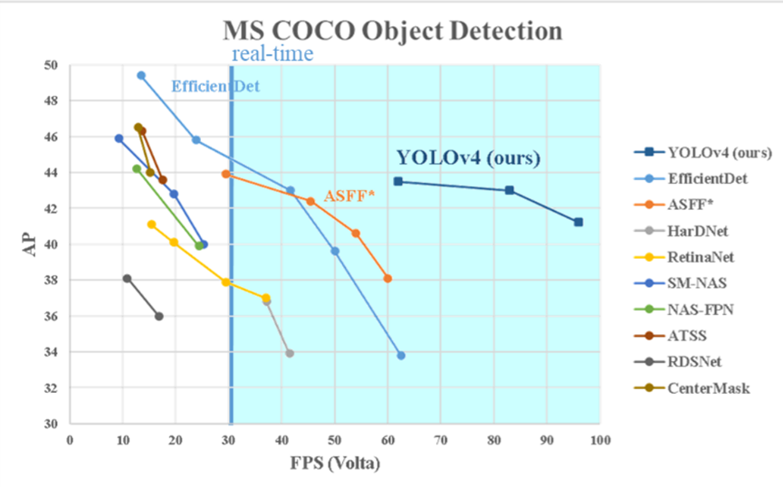
Performance of YOLO

Slide 4
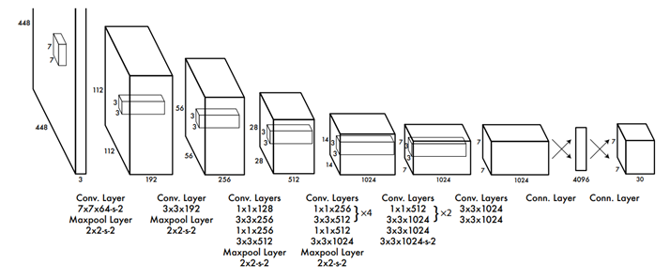
Structure of YOLO
24 convolutional layers
2 fully connected layers
An output layer of size 7×7×30

Slide 5
The output layer
7×7 grids, each gives out two predicted bounding boxes
4×2 parameters for descriptions of bounding boxes
2 parameters for confidence of objects

Slide 6
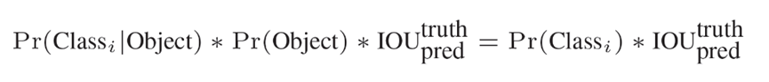
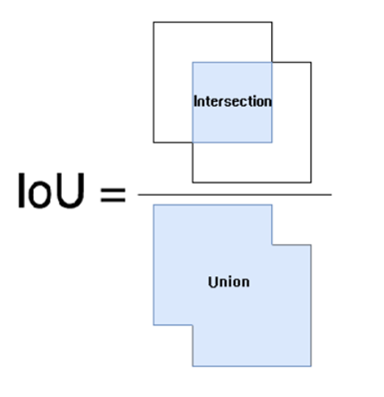
Confidence of result
IoU: Intersection over Union

Slide 7
Performance indicators
Precision
Recall
F1
AP and mAP

Slide 8
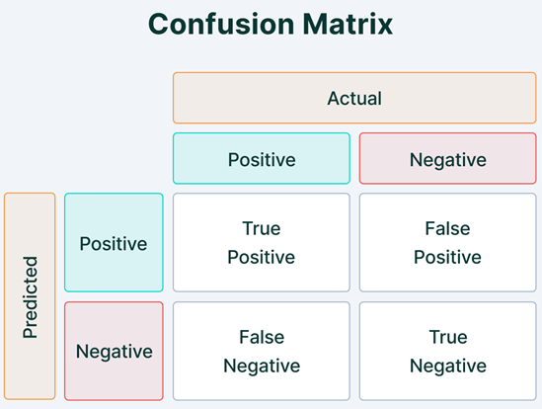


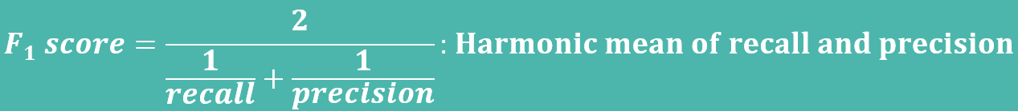

Slide 9
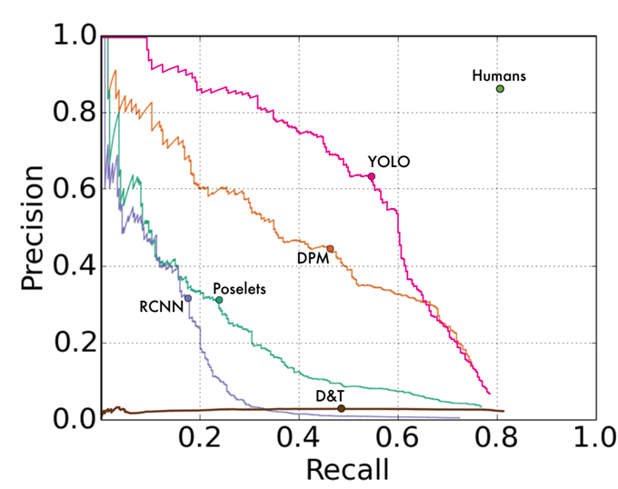
The P-R curve
AP: Average Precision at various recall levels.
Typically calculated by computing the area under the precision-recall curve.
mAP: The average of AP across all classes.

Slide 10
What have we done?
Environment Configuration
Transfer datasets into yolo format
Training data
First Look at the results
Comparison between Yolos

Slide 11


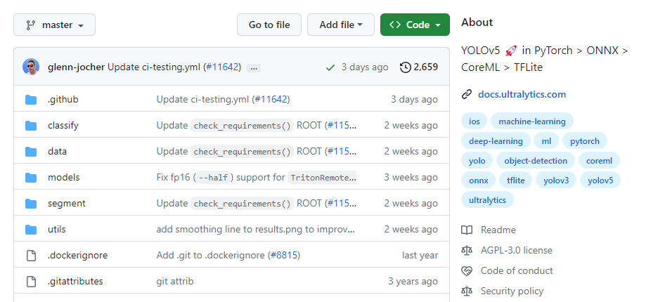
Environment Configuration
Python environment
CUDA and cuDNN
PyTorch
Yolov5 code respository

Slide 12
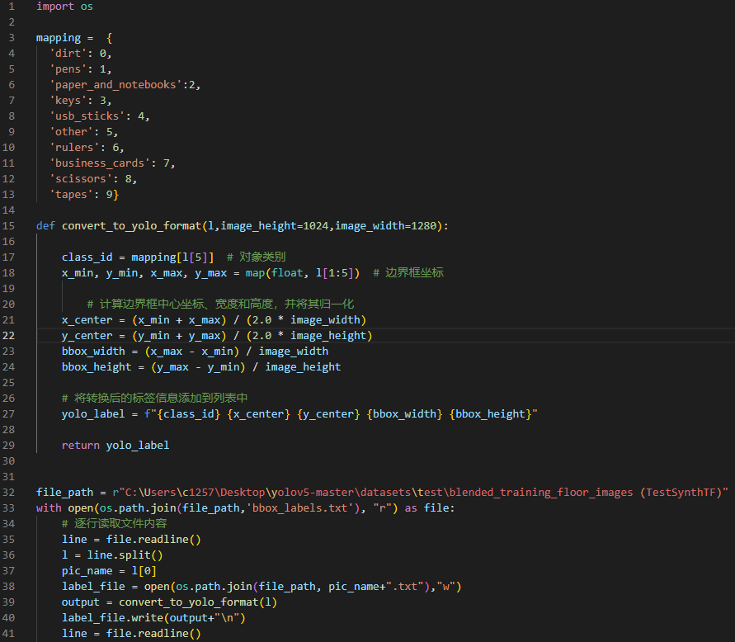
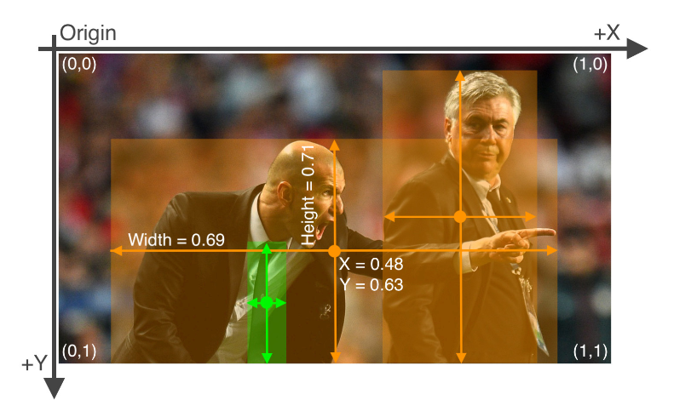
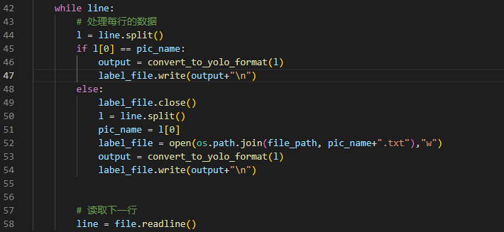
Transfer datasets into yolo format

Slide 13
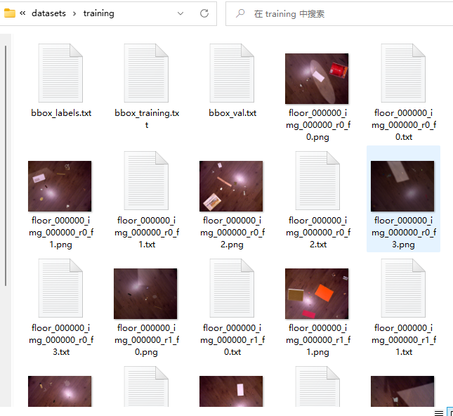
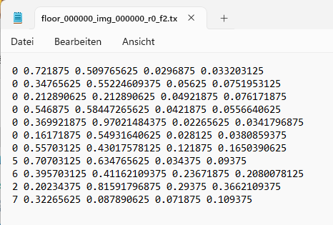
Transfer datasets into yolo format

Slide 14
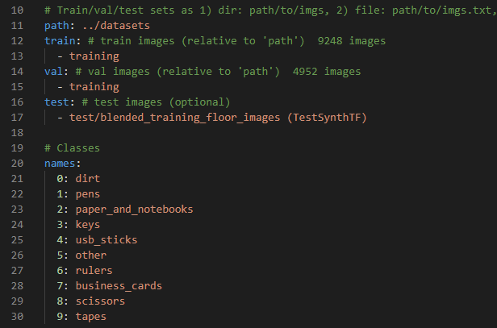
Training Data
create a yaml file
implement weight files (yolov5s.pt)
python train.py --img 640 --epochs 3 --data voc_dirt.yaml --weights yolov5s.pt

Slide 15
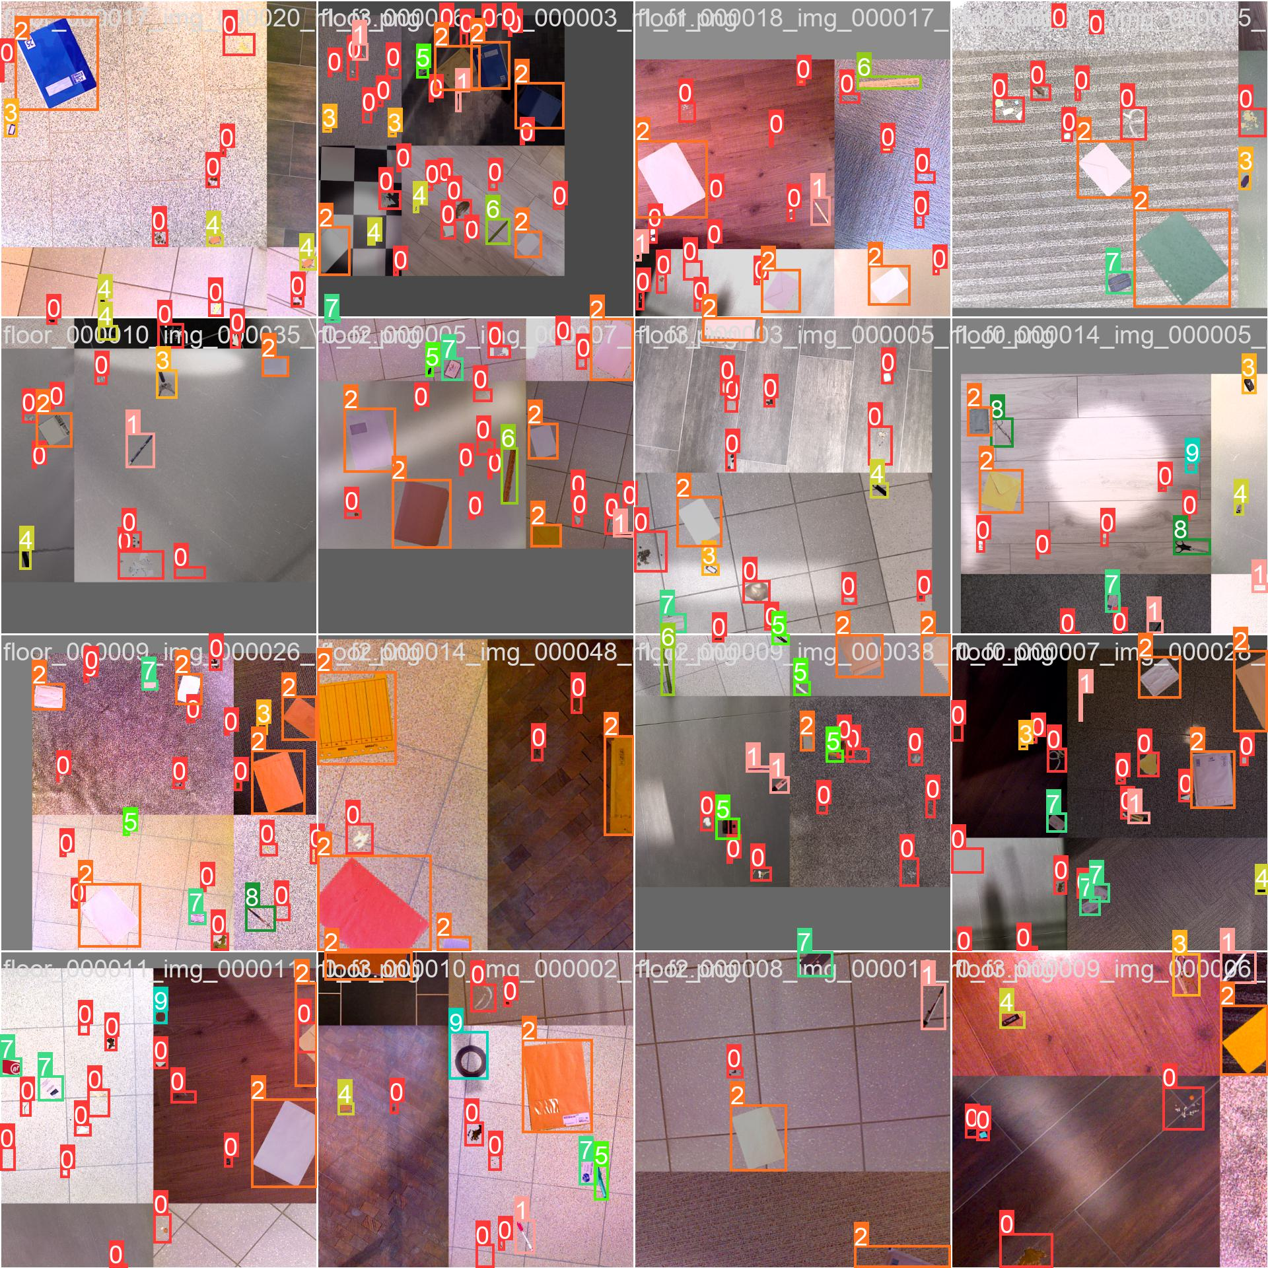
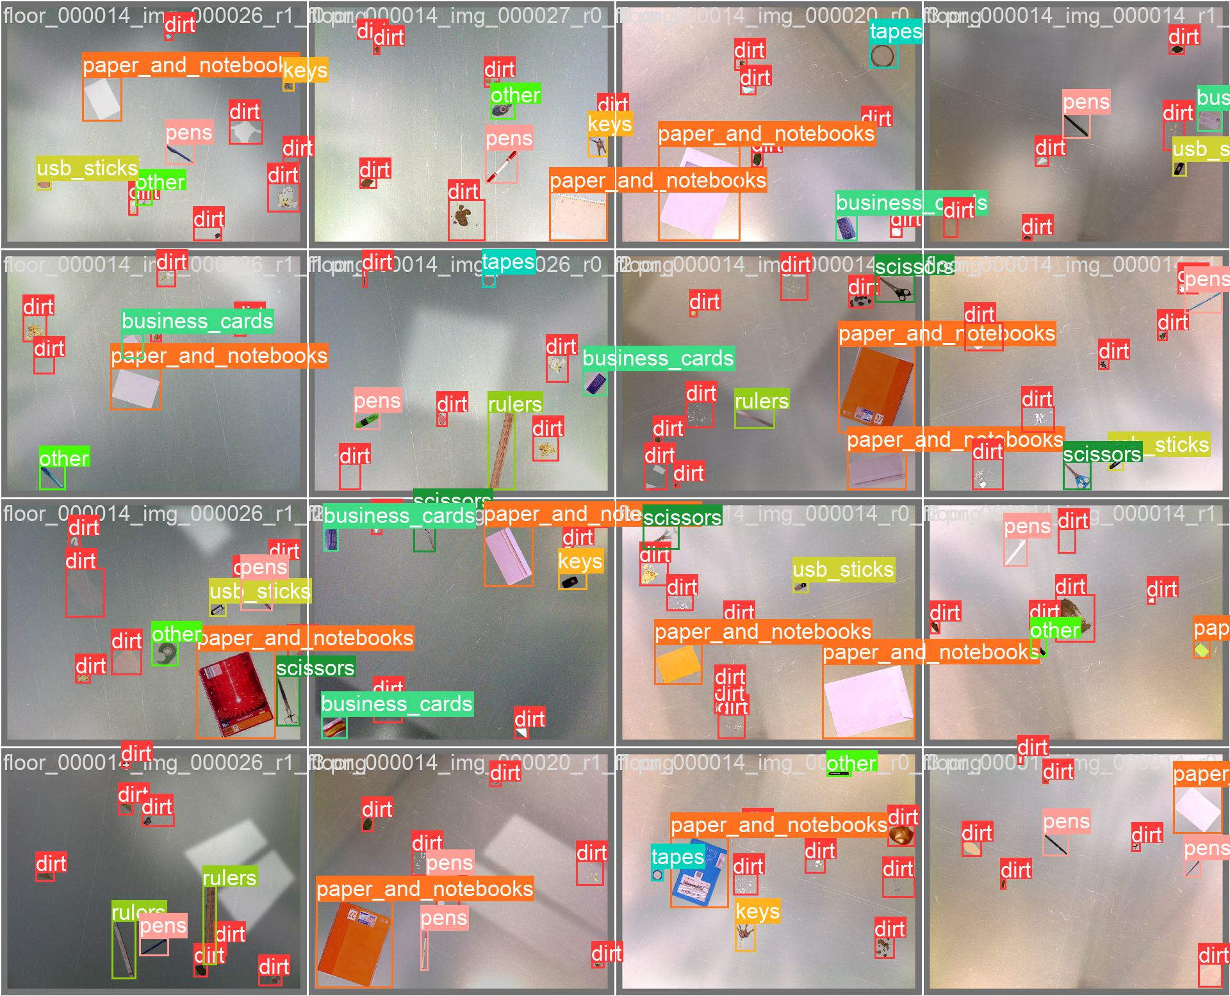
Results from training data

Slide 16
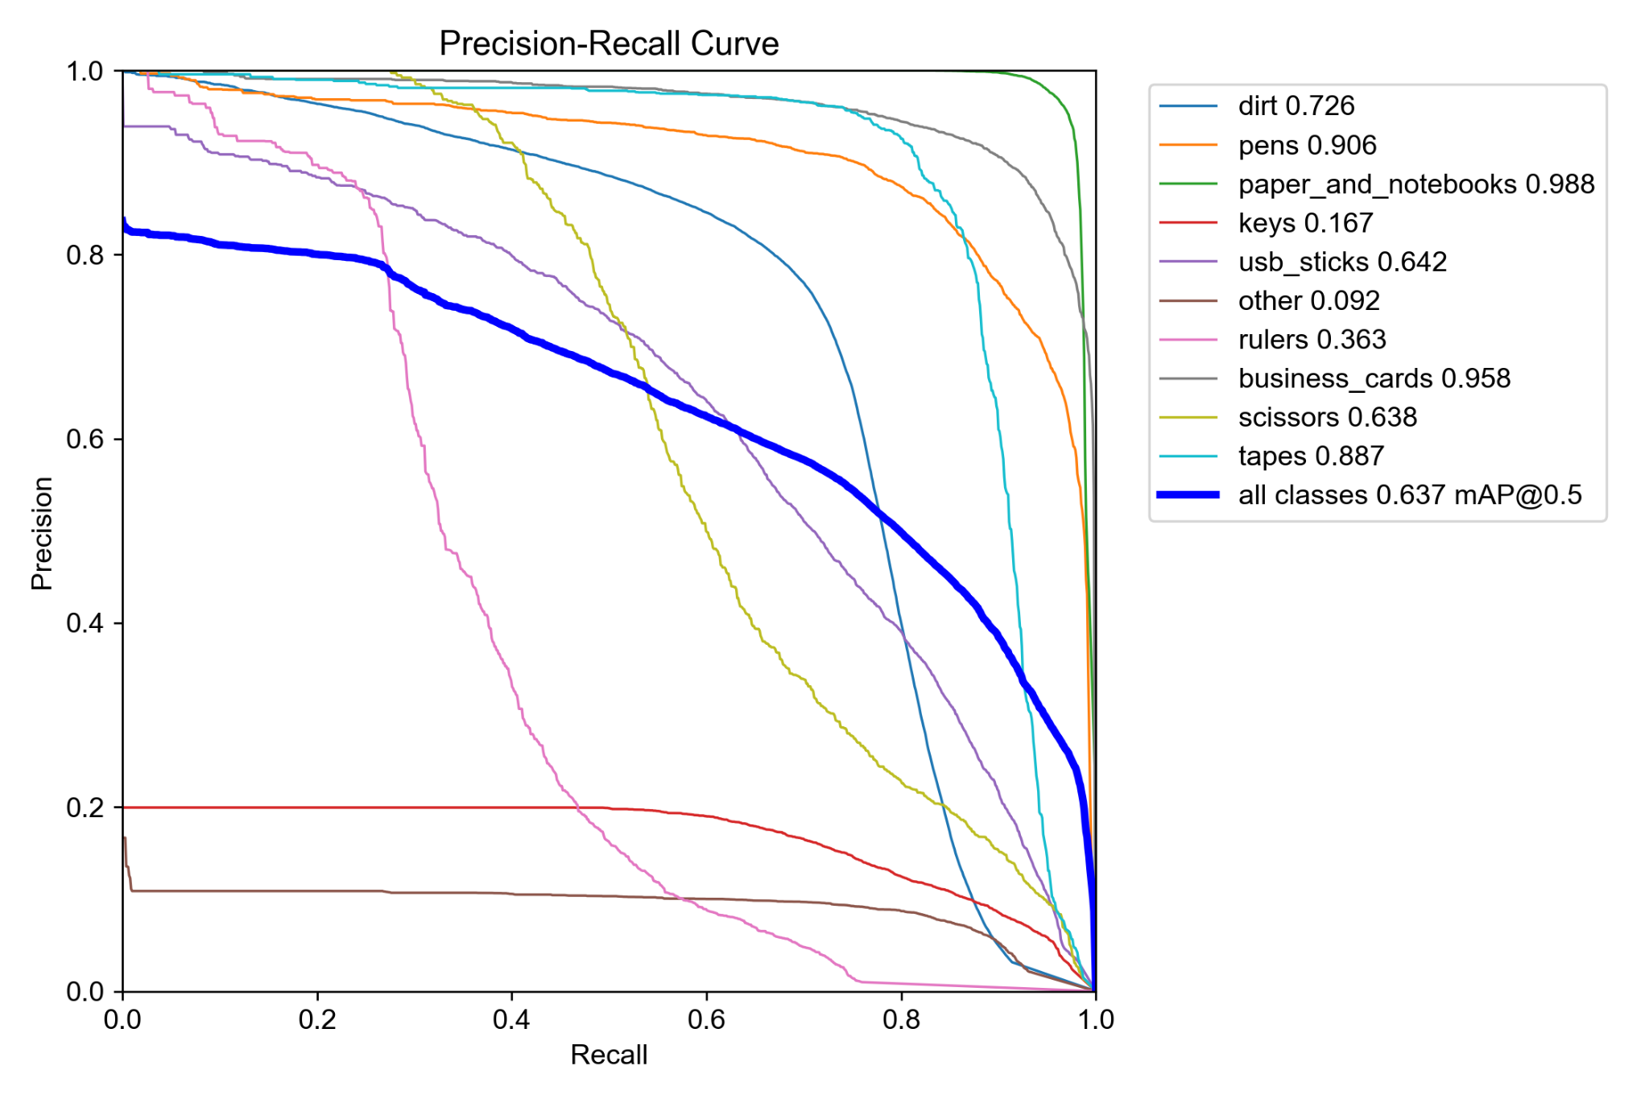
Results from training data
Training dataset of 9248 samples

Slide 17
YOLOv8 Implementation
Comparing YOLOv8 and YOLOv5
Results Improvement (Next Steps)
Data Augmentation
Problems

Slide 18
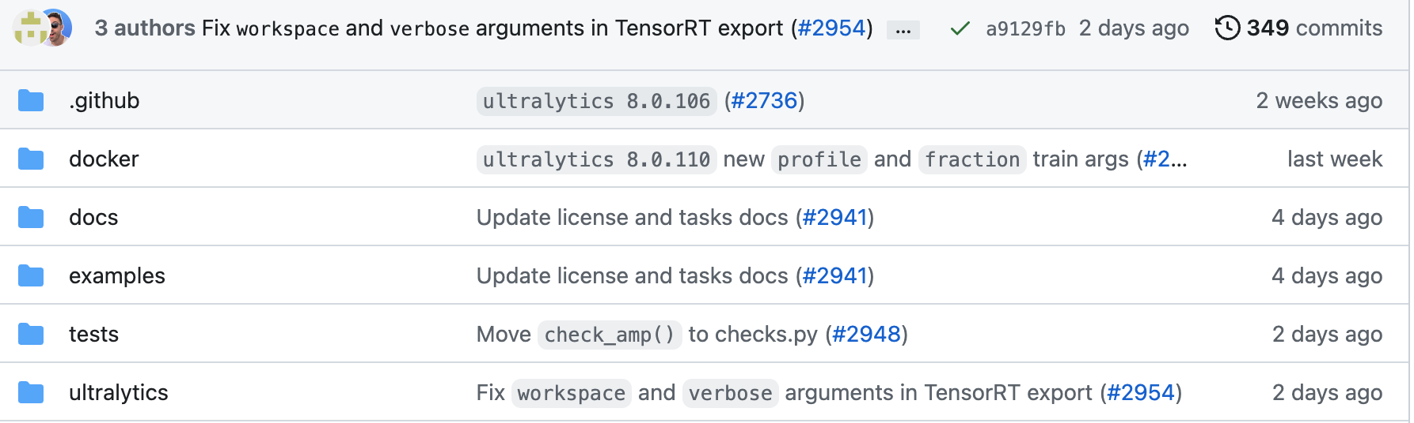
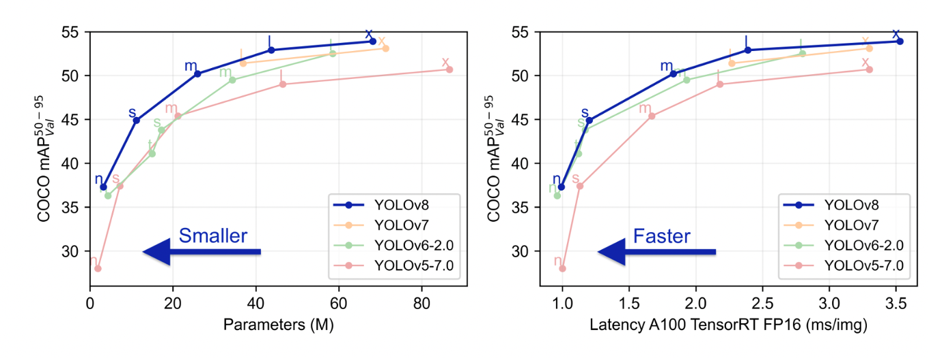
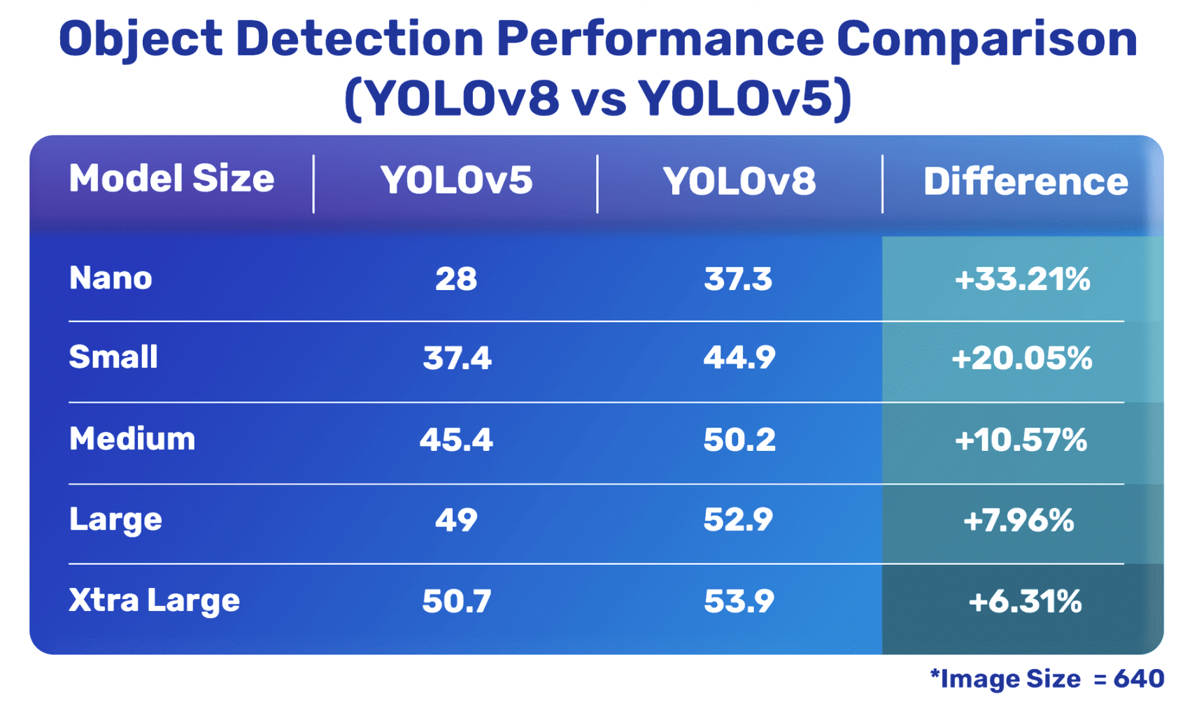
YOLOv8 vs YOLOv5
Differences:
easy-to-use CLI
well-structured Python package
Accuracy Improvements
Limited speed difference

Slide 19
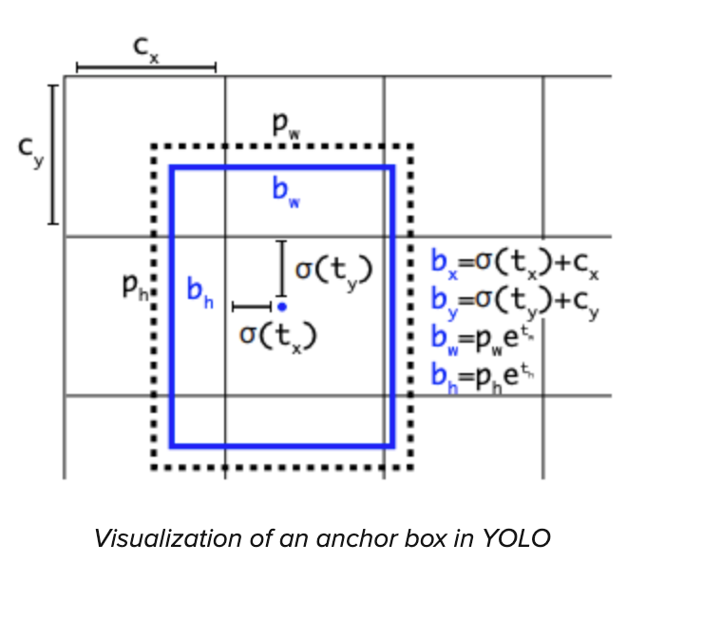
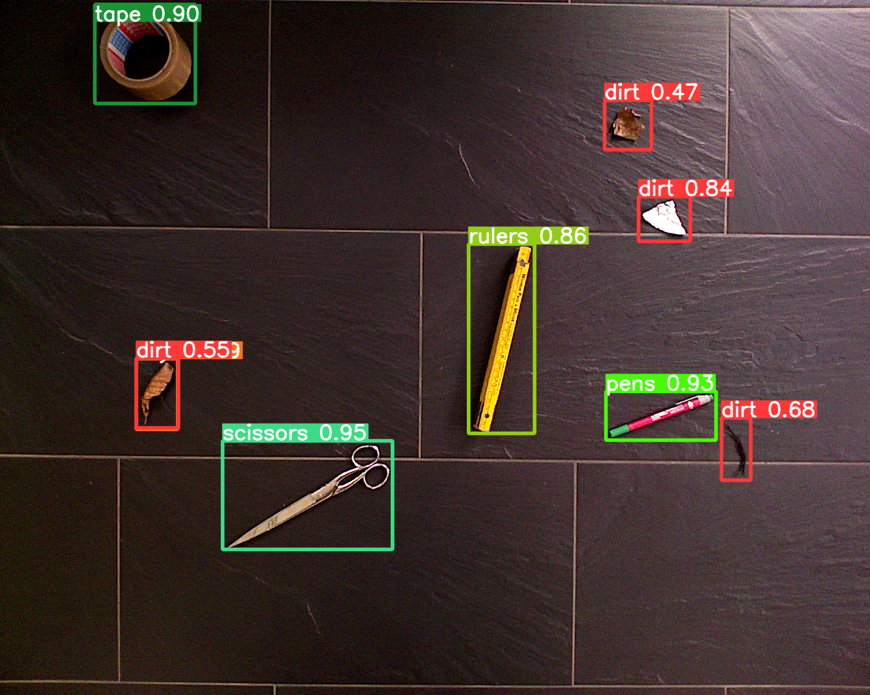
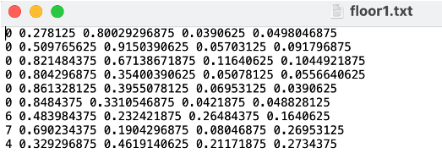
YOLOv8 vs YOLOv5
Similarities:
Anchor Boxes
Non-Maximum Suppression
Optimizer(Adam optimizer)
Activation Function(Mish activation function)

Slide 20
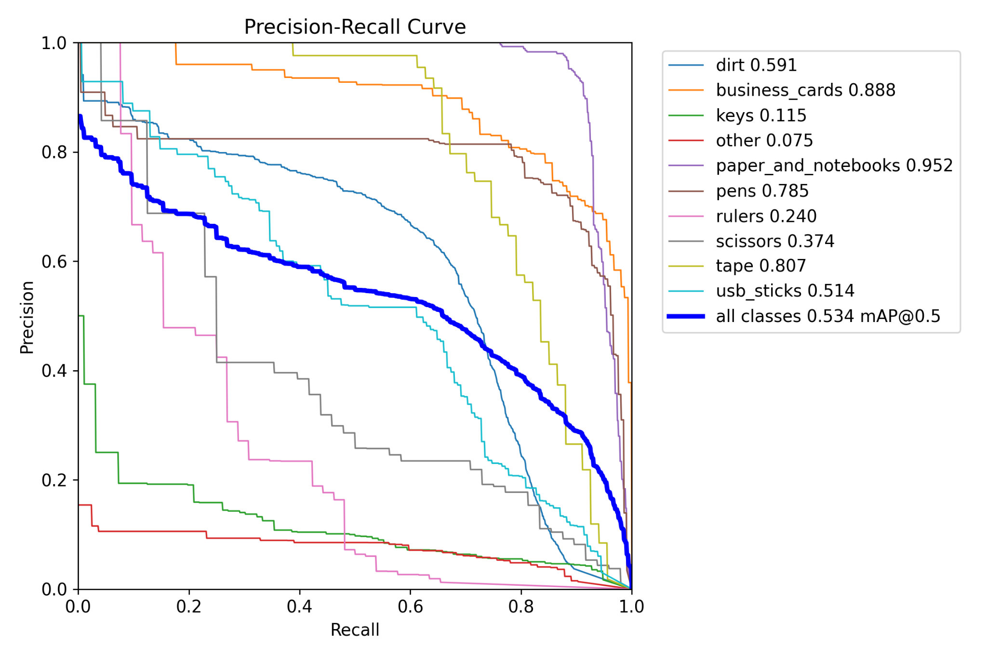
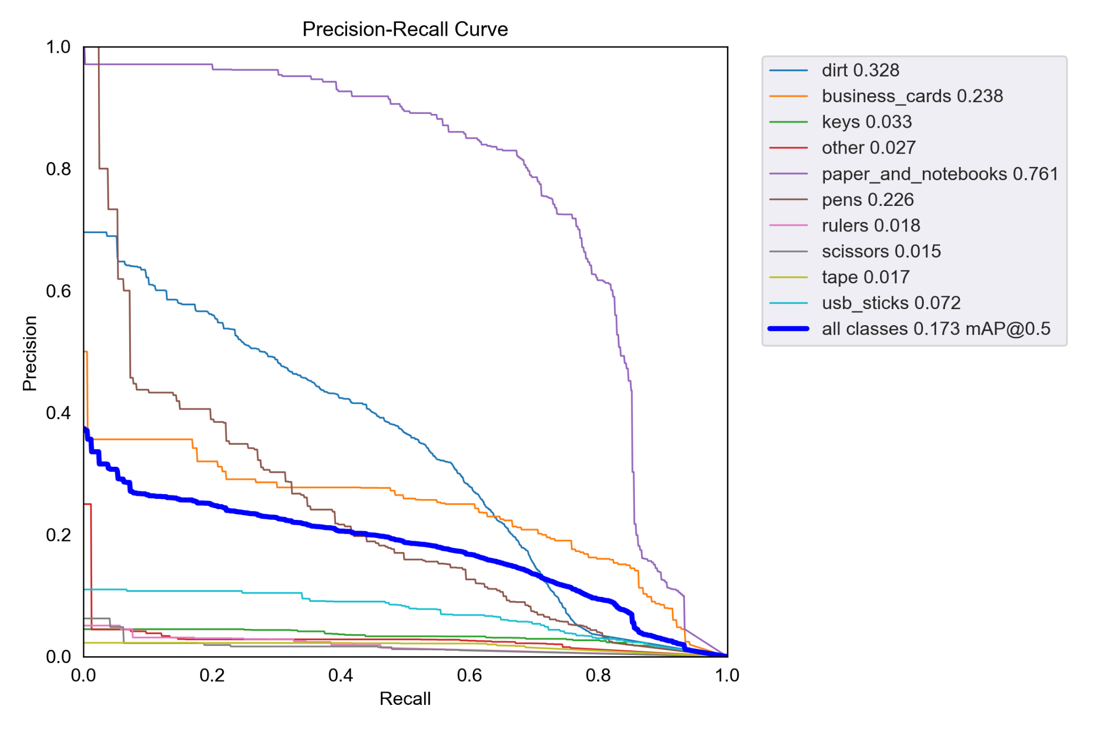
YOLOv8 vs YOLOv5
Results:
YOLOv8n(3 Epochs, 8 Batches)
YOLOv5n(3 Epochs, 8 Batches)

Slide 21
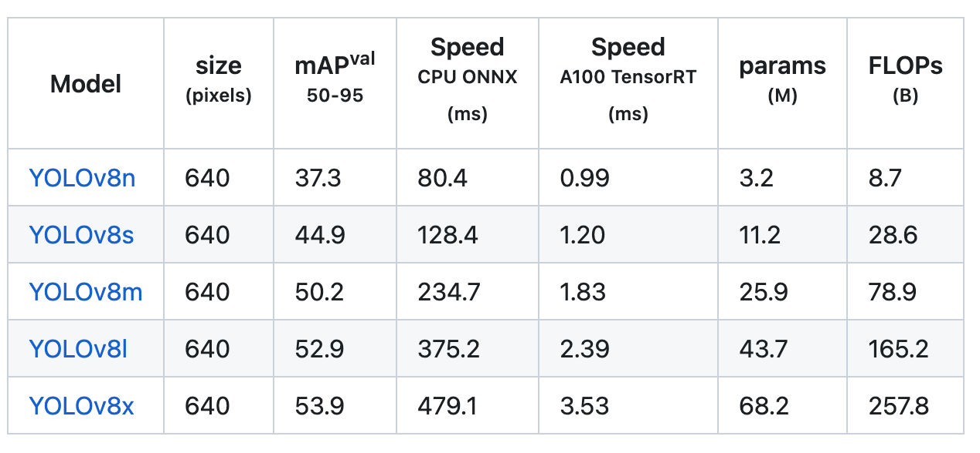
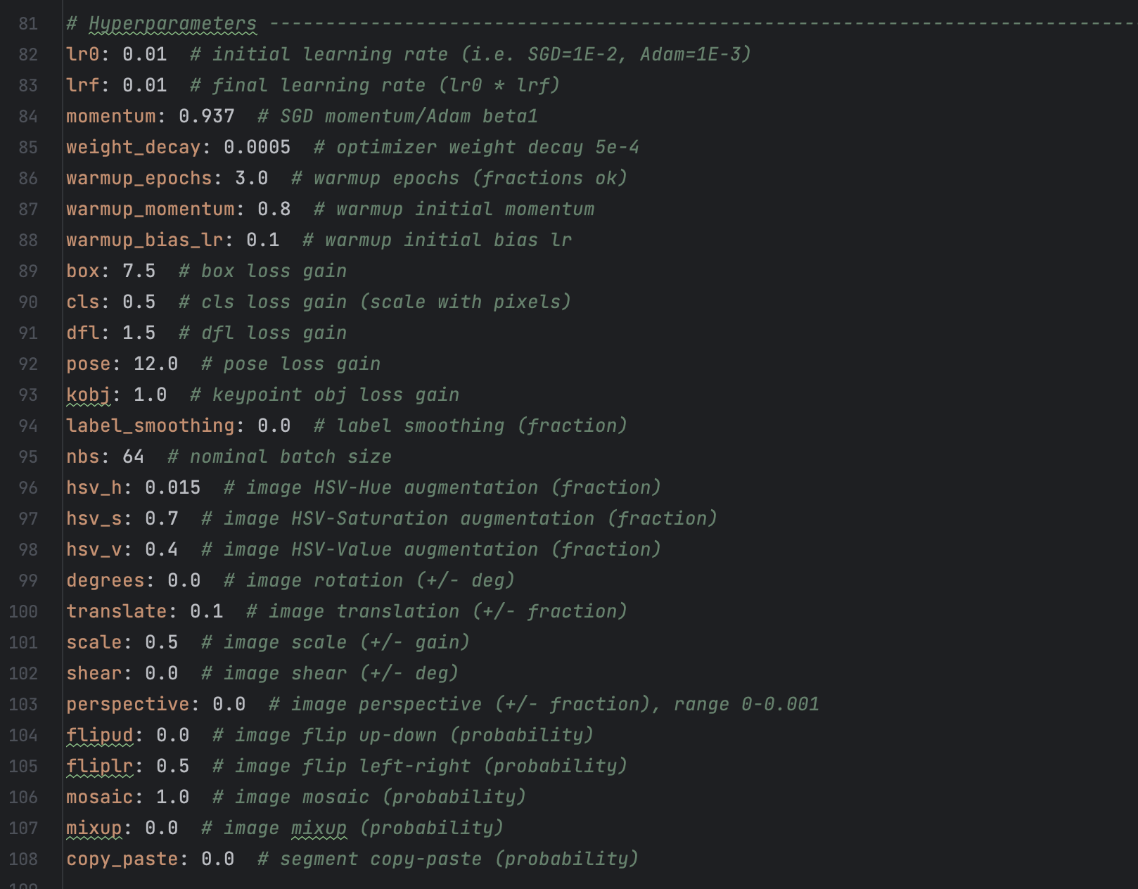
Results Improvement
Next Steps:
Trying different model type (YOLOv8s)
Training with larger dataset (≥ 1500 images per class recommended)
Training Settings (more Epochs without overfitting and larger Batch size)
Data augmentation (Hyperparameters modifying in default.yaml file)

Slide 22
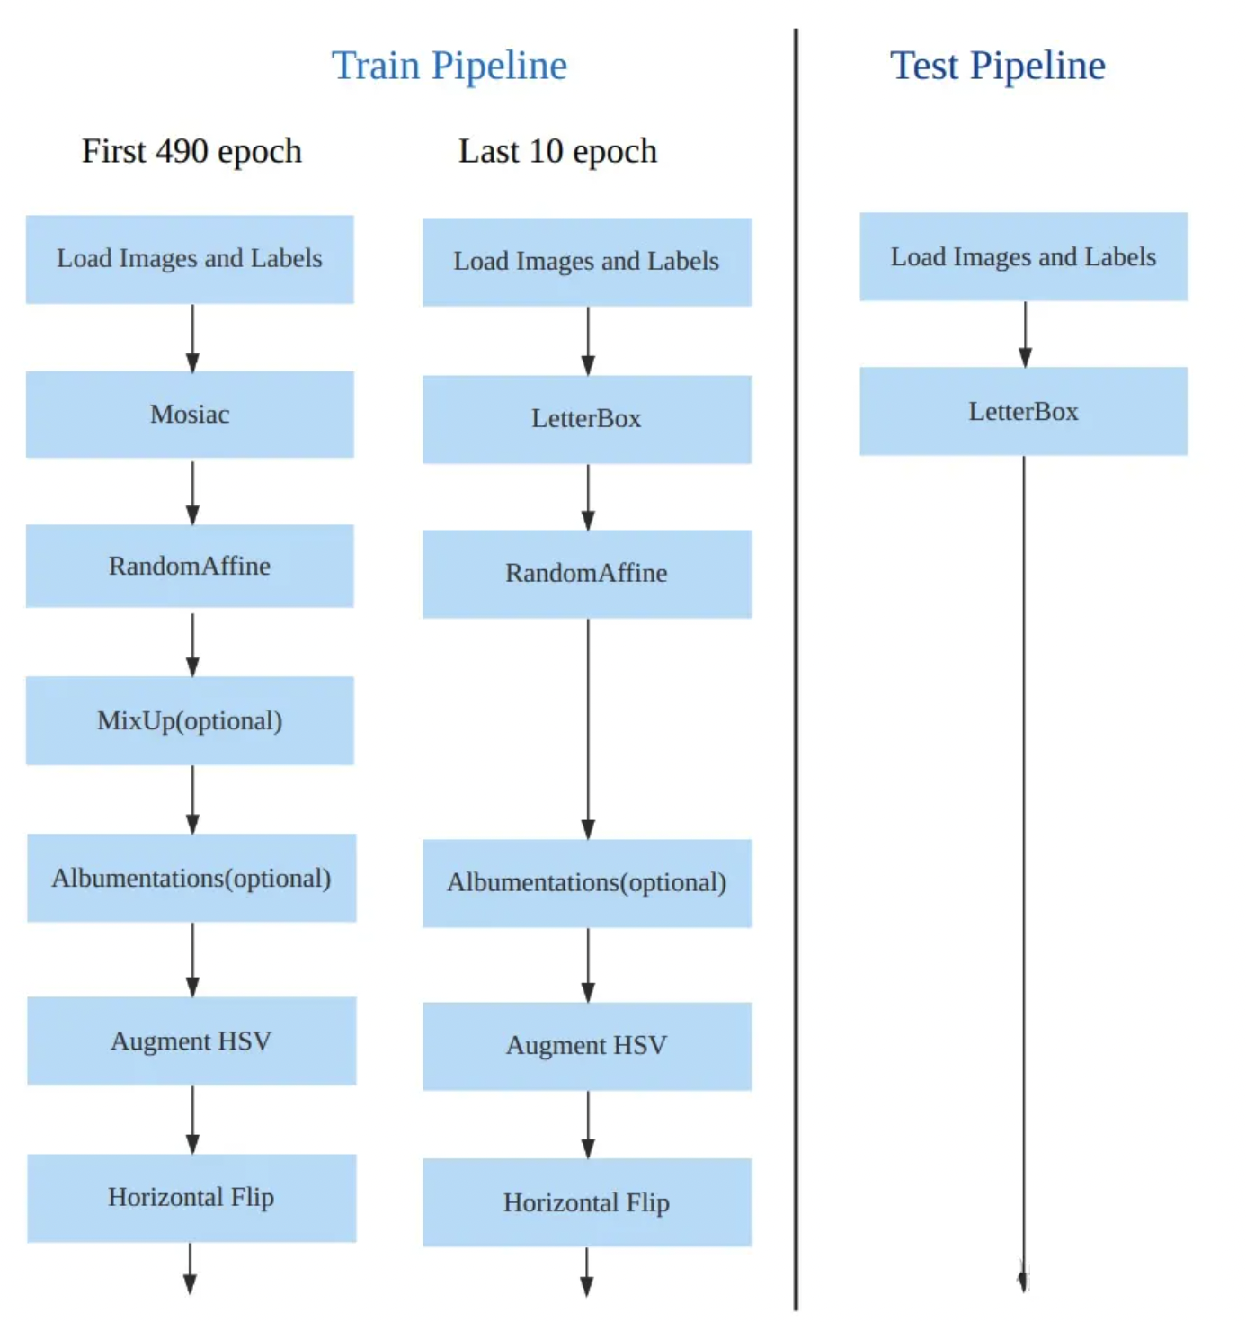
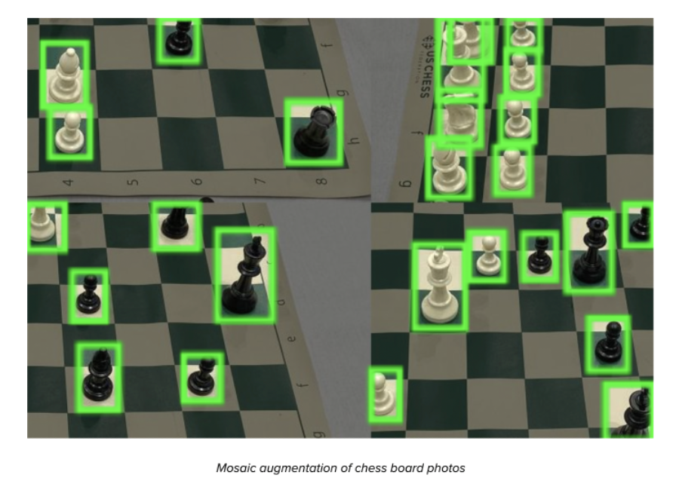
Data Augmentation
Mosaic Augmentation:
Take 4 images and combine them into a single image as the new mosaic image.

Slide 23
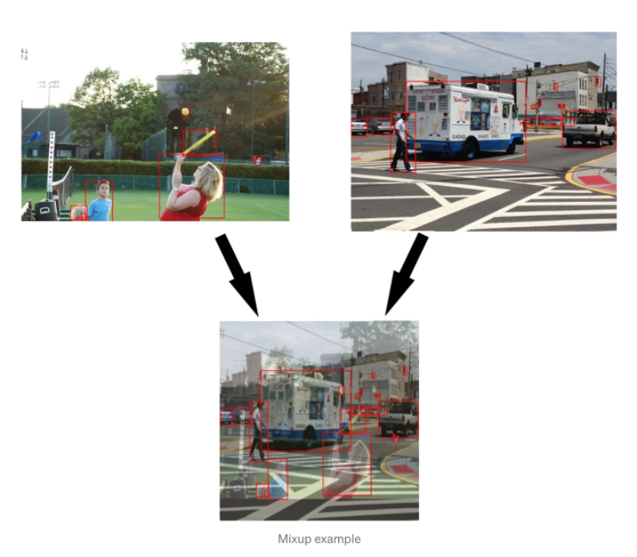
Data Augmentation
Mixup Augmentation:
Combine two different images and their associated labels to create a new synthetic sample.

Slide 24
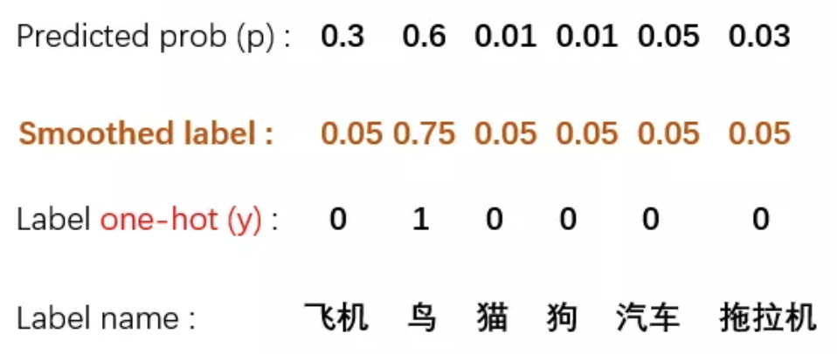
Data Augmentation
Label Smoothing:
This involves modifying the ground truth labels during training to introduce a small amount of uncertainty or noise in the label assignments.

Slide 25
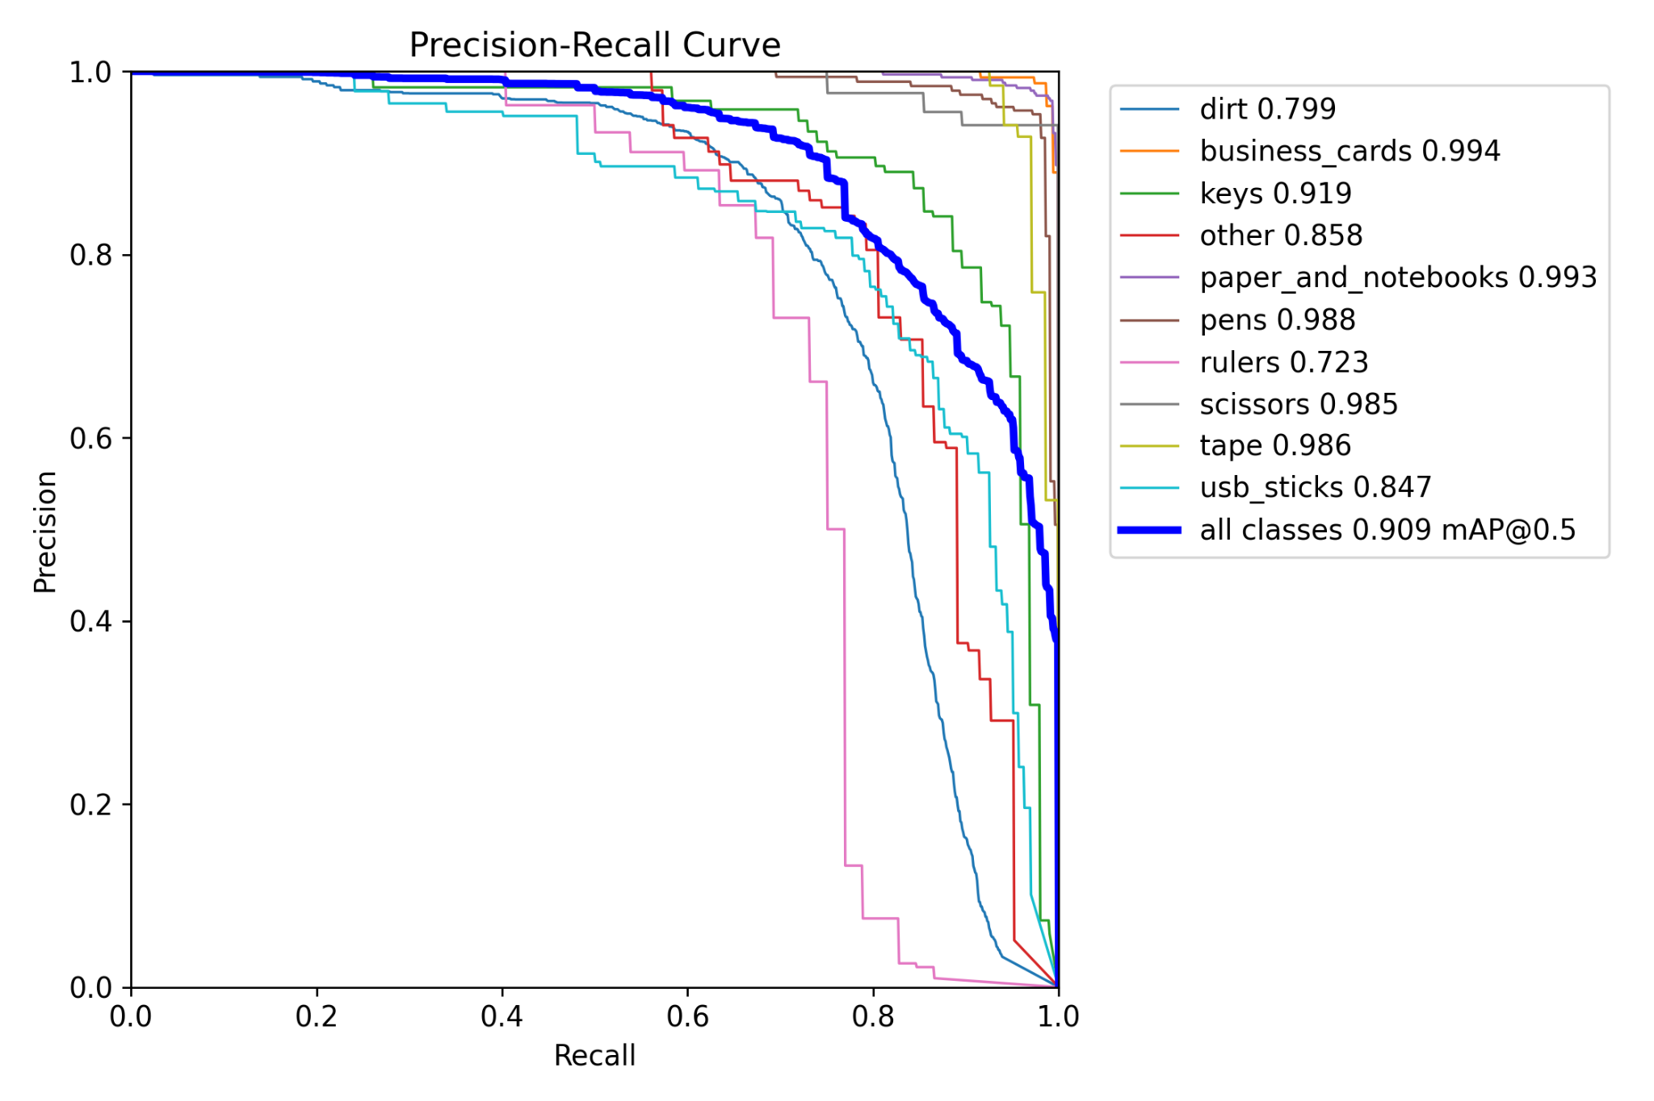
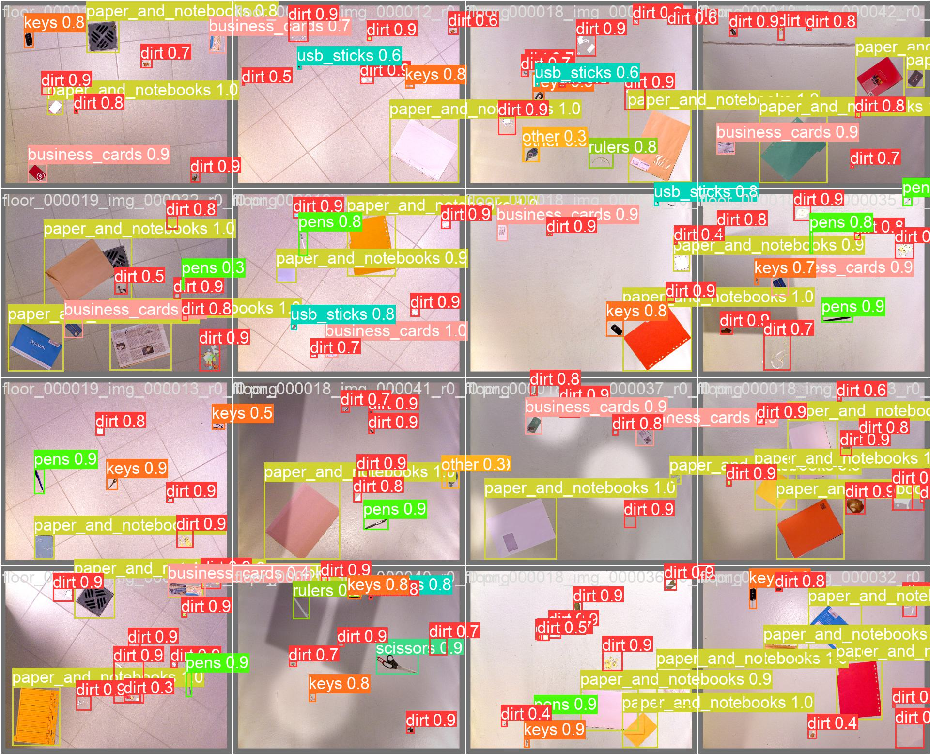
Latest Result
YOLOv8s model (30 epochs, 8batches, 1156 pictures for training and validation, 80 pictures for test)

Slide 26
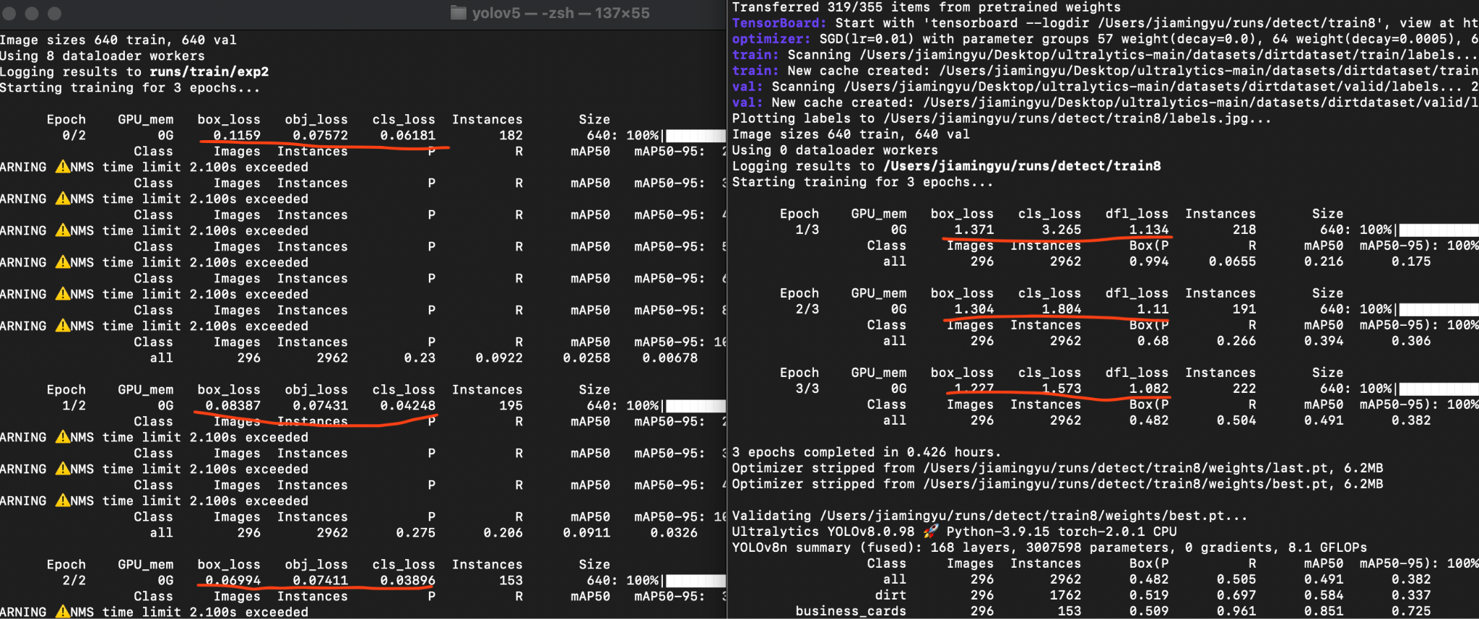
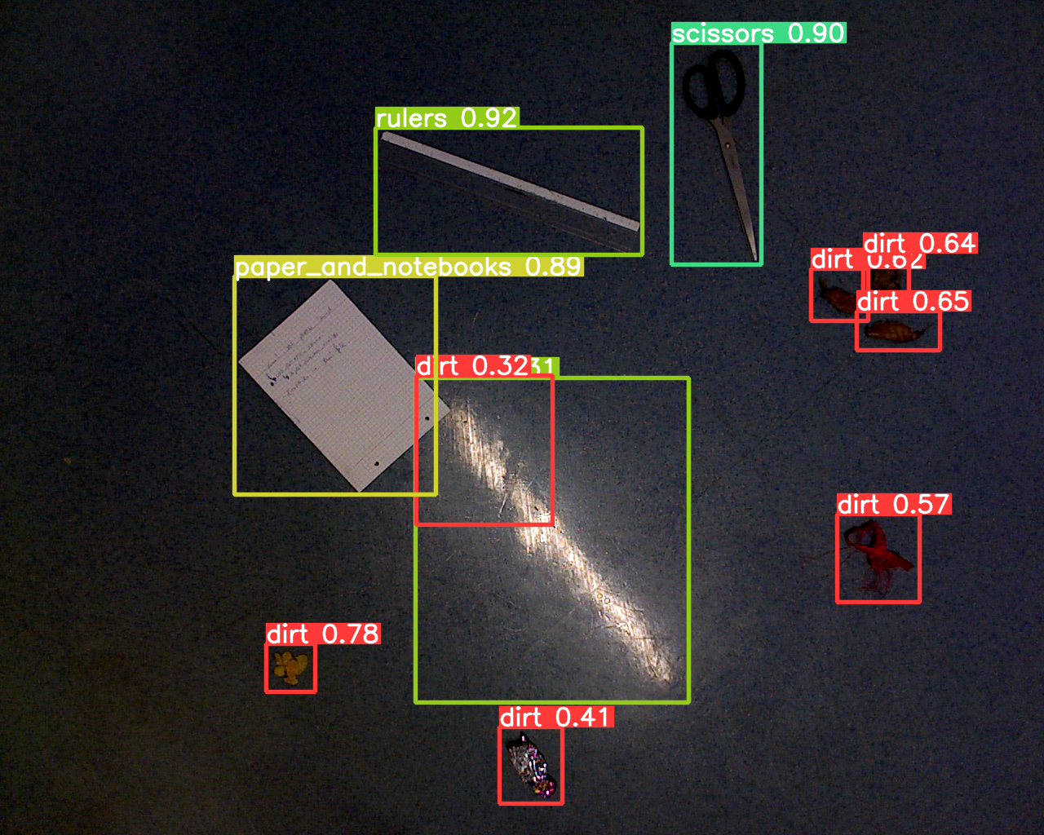
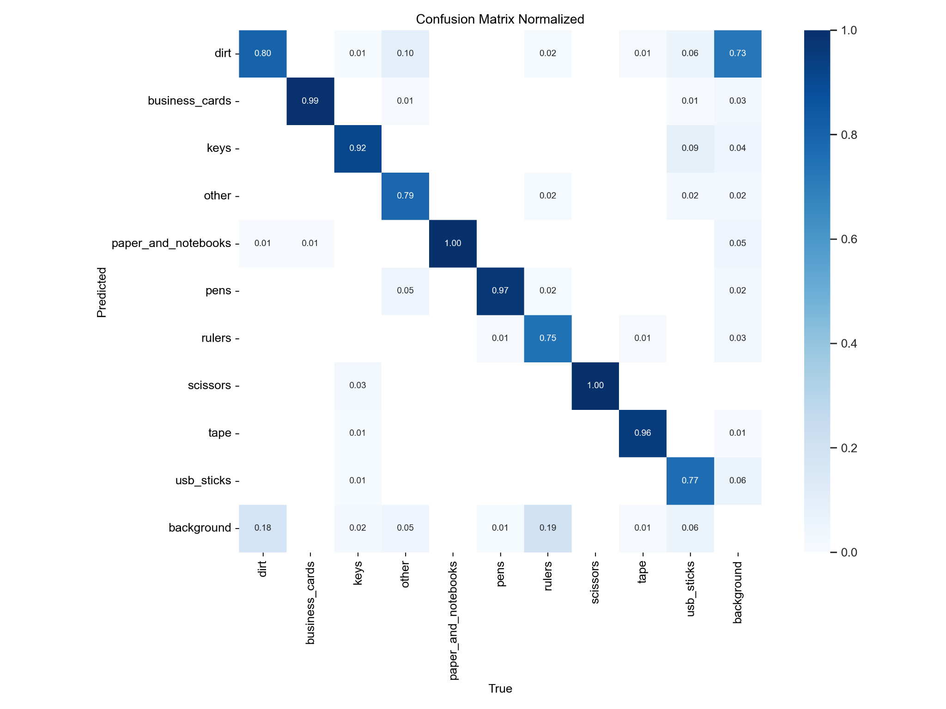
Problems:
Why does YOLOv8 have larger loss but still higher mAP scores than YOLOv5?
How to avoid the background being detected as dirt.

Slide 27
Thank you for your attention!

